Slide 1

Exploratory Analysis of CTA and Census Bureau Data

Slide 2


Data Sources
CTA data sets
L Station Entries
Annual ridership
Daily Ridership Totals
L Station Locations
Census Bureau Data
Housing
Income and Education
Gender and Age
Occupation and Commute
Filtered to only select data from the 6 Counties around Chicago

Slide 3
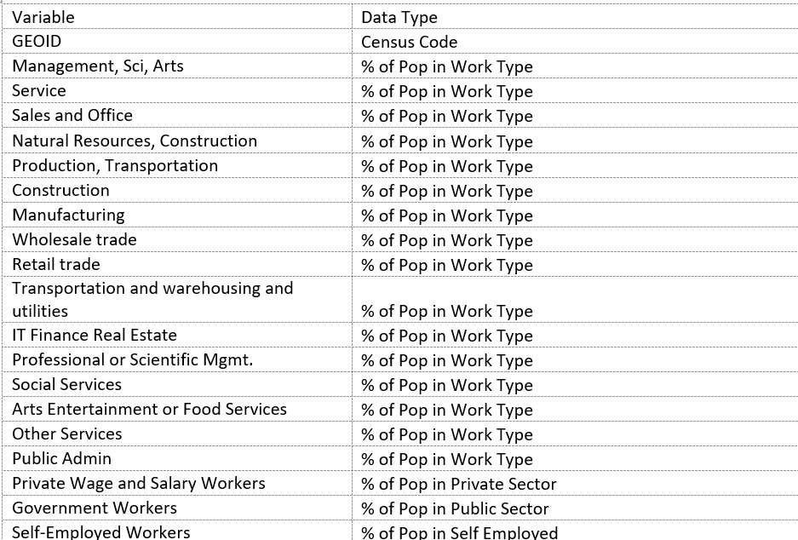
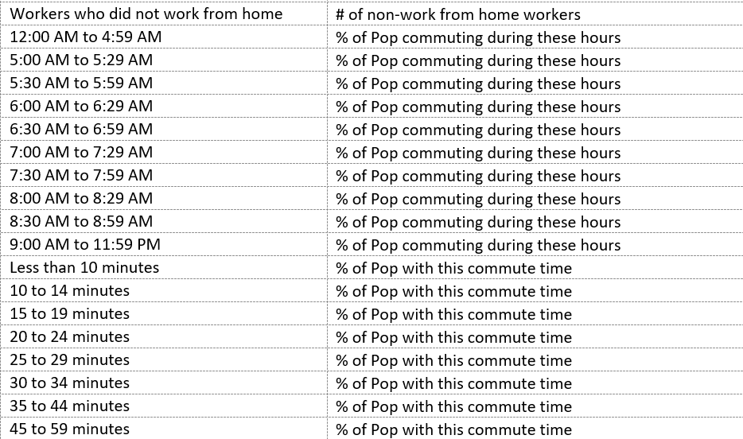
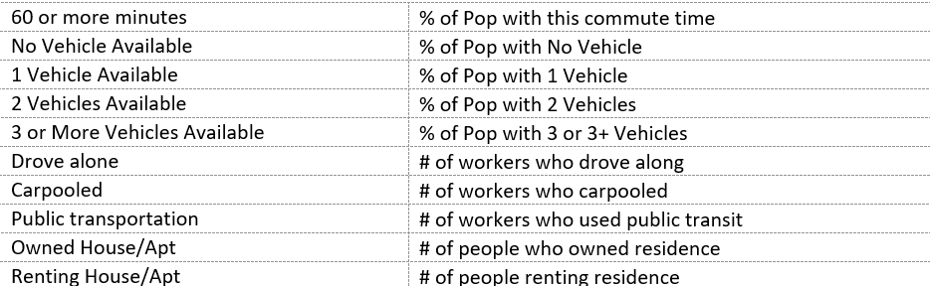
Variables

Slide 4
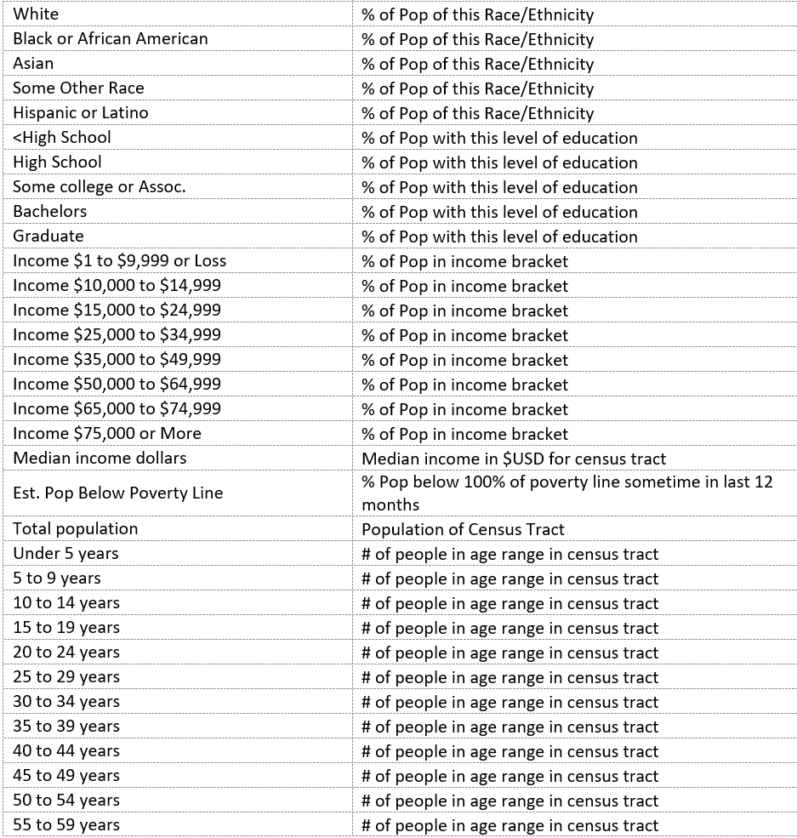
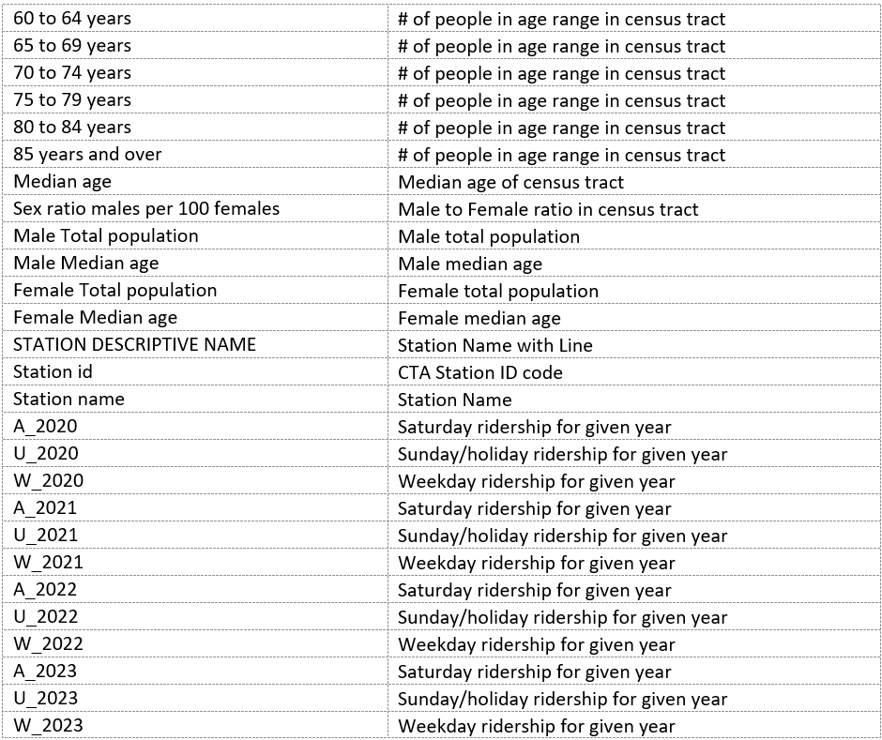
Variables cont.

Slide 5
Target Variables
Average Ridership for each day type in 2023
U = Sunday and Holidays
A = Saturdays
W = Weekdays
Target Variable names in dataset
A_2023
U_2023
W_2023

Slide 6
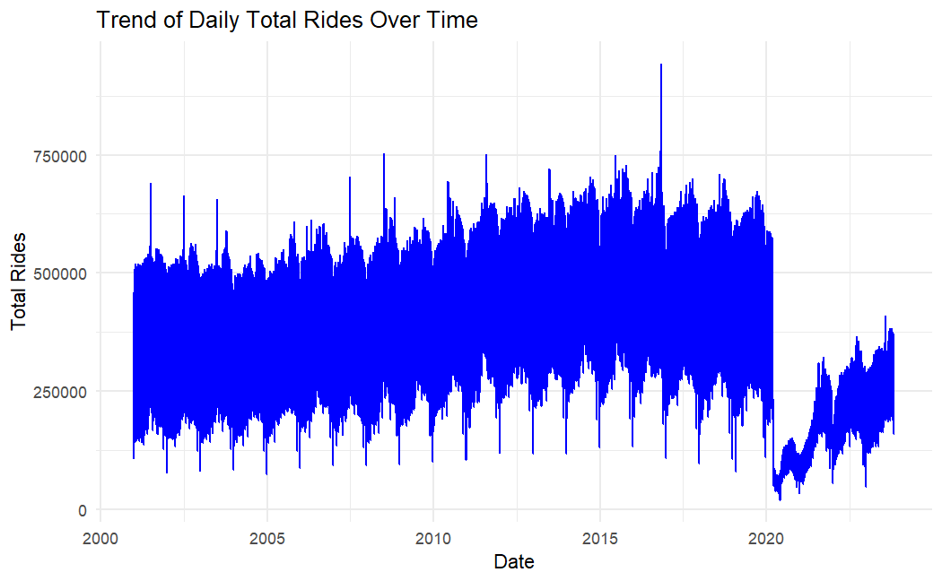
Ridership changes over time
General increase until 2020
Covid-19 Impact
Slow return to pre-pandemic levels

Slide 7
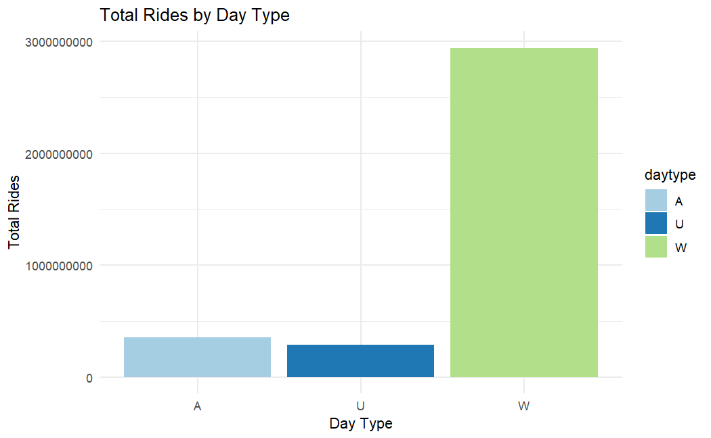
Distribution of Rides by Day Type
U = Sunday and Holidays
A = Saturdays
W = Weekdays

Slide 8
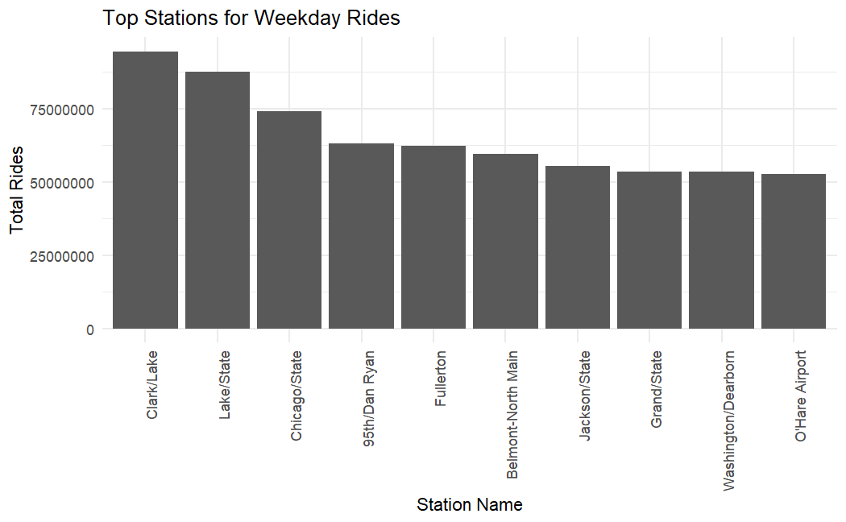
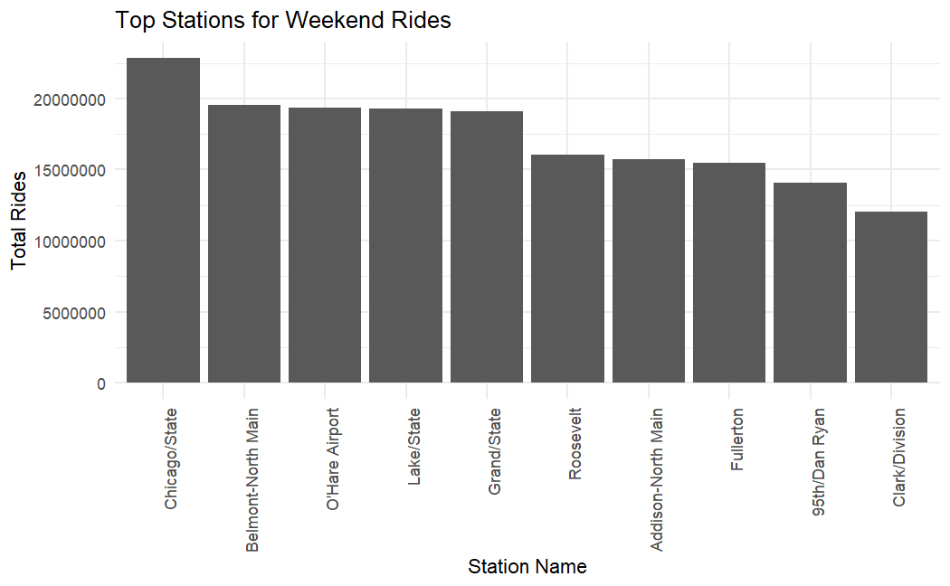

Slide 9
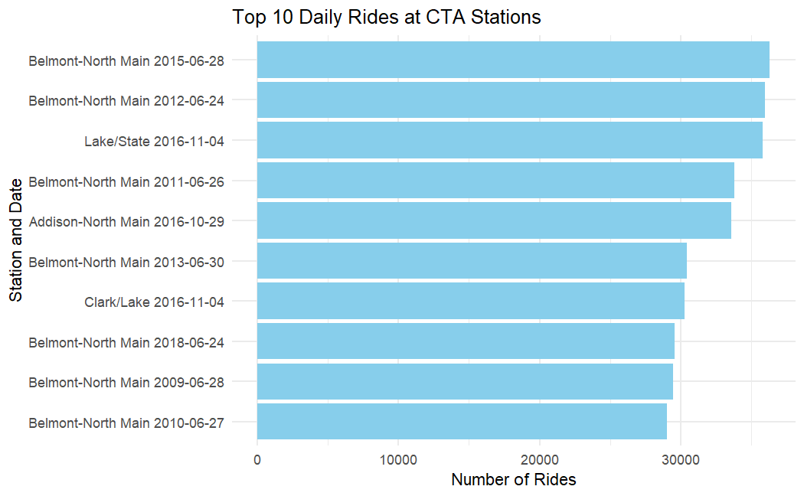

Slide 10
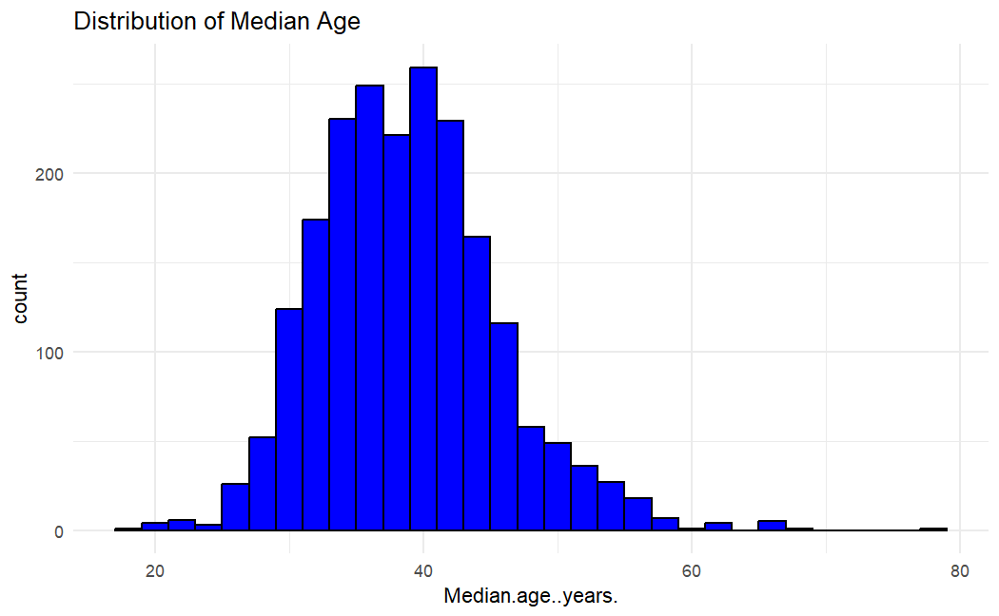
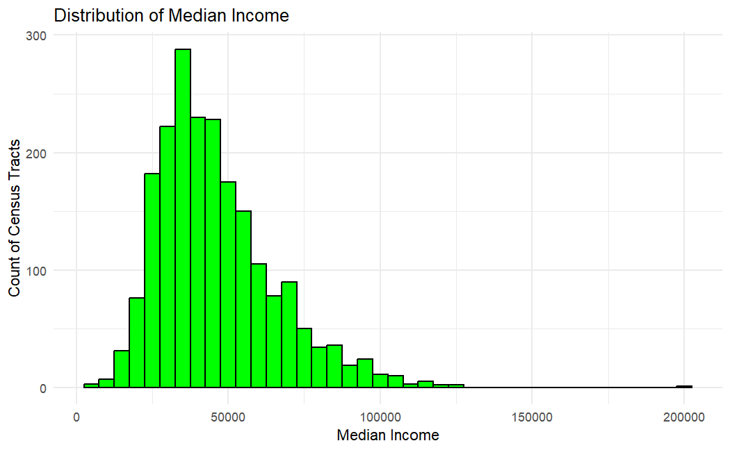
Census Bureau Data

Slide 11
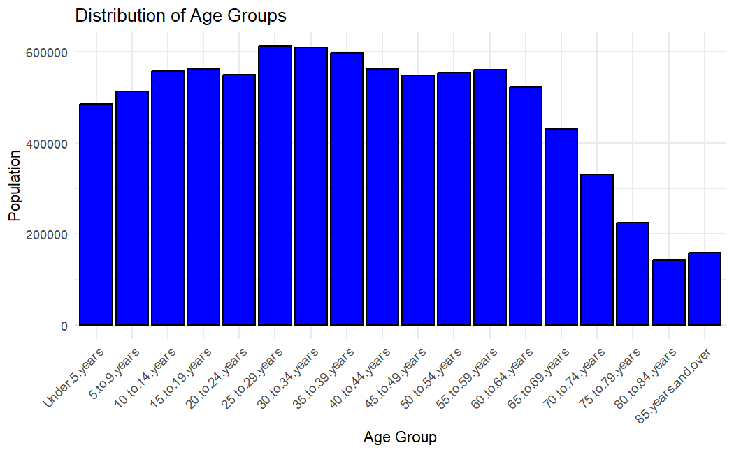
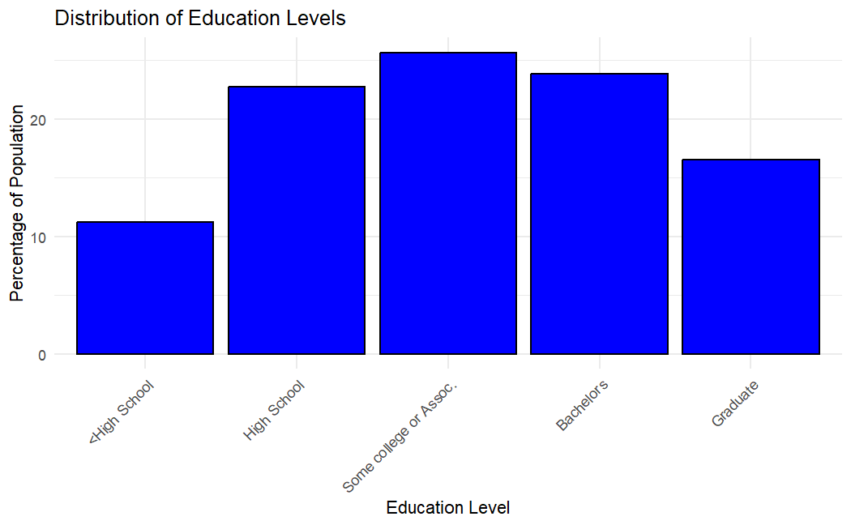
Census Bureau Data

Slide 12
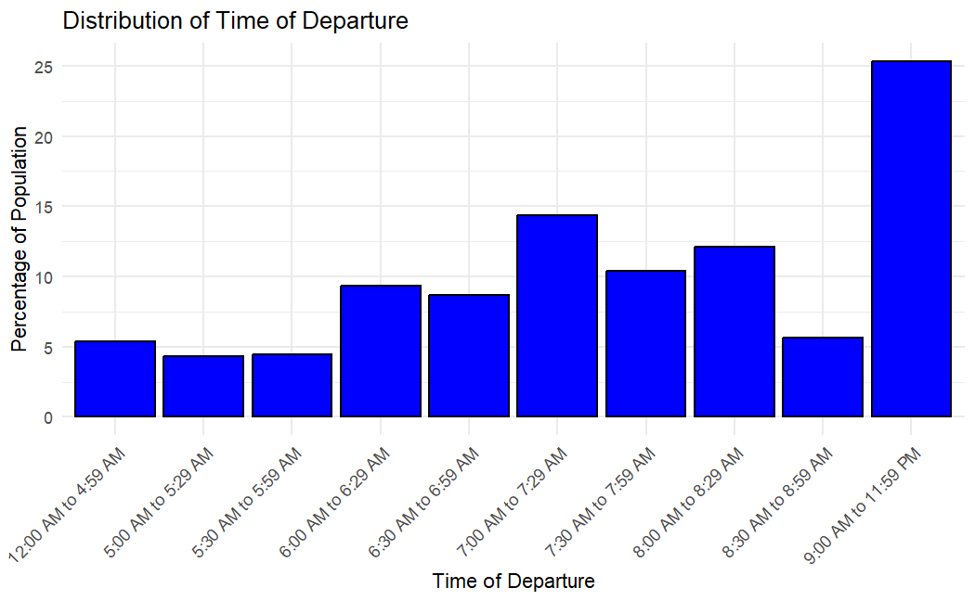
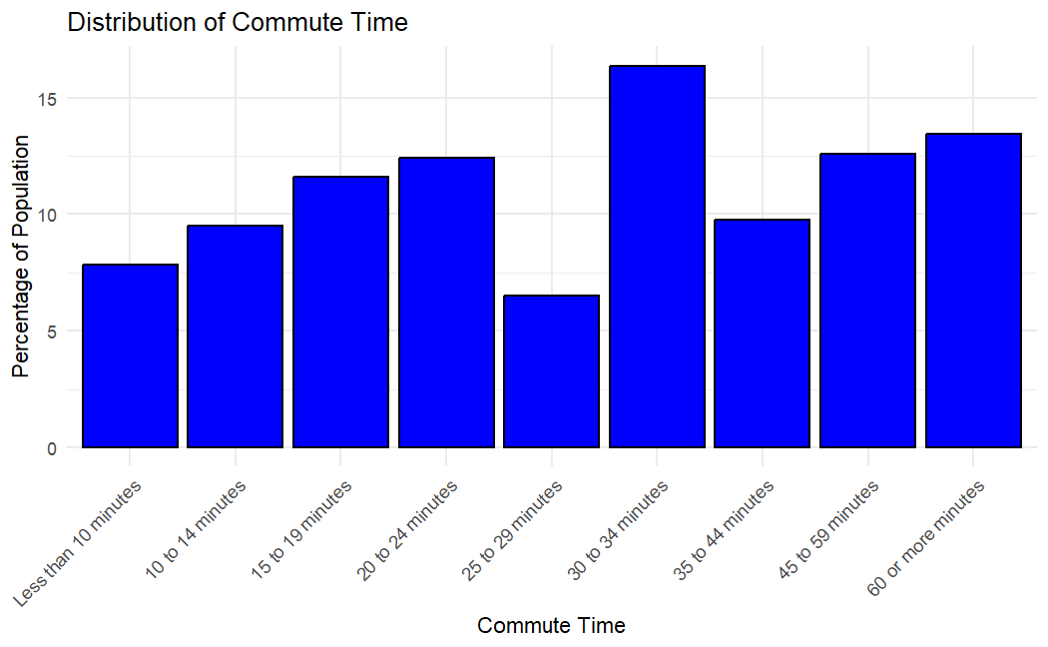
Census Bureau Data

Slide 13
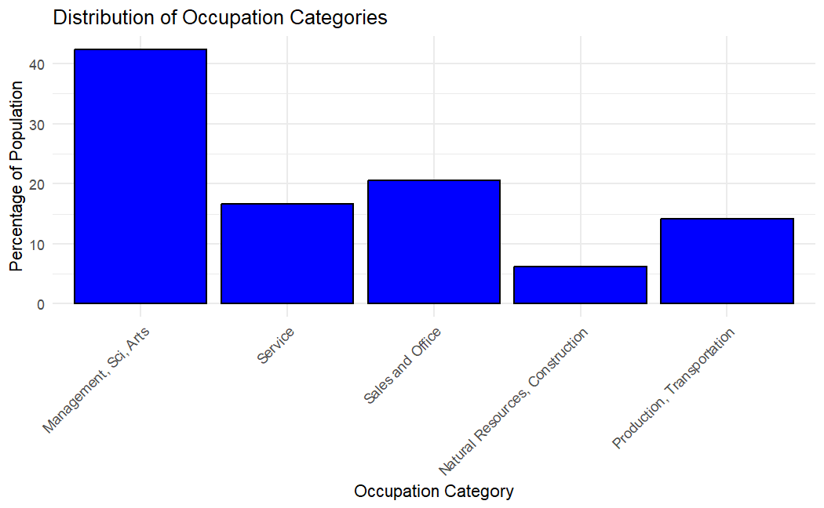
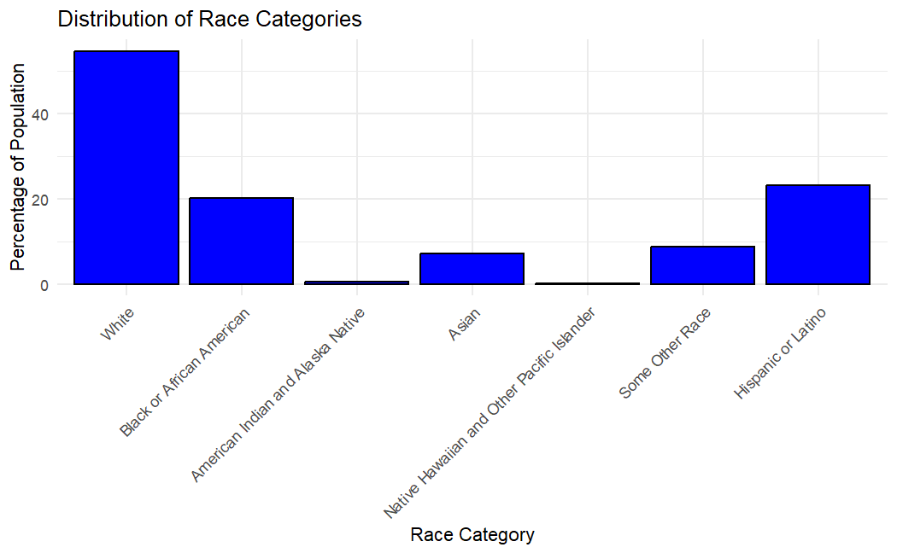
Census Bureau Data

